Slide 1
Niagara Gorge Corridor
Parkway Removal Project: Main Street to Findlay Drive
Niagara Falls, NY
Public Information Meeting
October 26, 2017
NYS Office of Parks, Recreation, & Historic Preservation
New York Power Authority
NYS Department of Transportation
City of Niagara Falls, NY
USA Niagara Development Corporation
Notes:
Good evening – My name is Paul Tronolone and I am a Project Manager with USA Niagara Development Corporation.
The time is now 6:00 PM and I’d like to officially call the formal portion of this public design hearing to order.
On behalf of the New York State Office of Parks Recreation and Historic Preservation – or “State Parks” – as well as several other agency partners (which I’ll go over in a moment) -- I will be presiding over tonight’s hearing to receive comments on the Design Report and Environmental Assessment – or DR/EA – for the Robert Moses Parkway Removal Project – running from Main Street to Findlay Drive in Niagara Falls, NY.
I will be assisted in the technical presentation tonight by Tom Donohue, the project manager from Parsons Transportation Group, the Project’s engineering consultant, as well as Anthony Dispenza from the NYS Department of Transportation.
At this point, I’d like to invite Mark Thomas, State Parks’ Western District Director, to the podium to welcome you and make some opening remarks.

Slide 2
Agenda
Welcome
Project Status/Schedule
Overview/Orientation
Addressing Prior Public Comments
Project Staging
Adjourn to Lobby for Review of Plans
Notes:
This is the agenda for tonight’s hearing. After this introduction I will go over the purpose of the hearing and some Project background – including what we’ve been working on since our last public meeting in September 2015.
We’ll then go over the Project alternatives that led us to what we refer to as the “Build Alternative” or the Project components that are the subject of this environmental review, and the we will walk you through these features – as part of that Tom Donohue will present a future traffic simulation of the Project.
We will then provide a summary of the anticipated social, economic, and environmental effects of the Project that is documented in detail in the DR/EA.
As is required under the NYS Eminent Domain Procedural Law, Anthony Dispenza will then provide an overview of DOT procedures to secure any temporary or permanent right-of-way that is necessary for the Project – although no major residential or commercial takings or displacements are anticipated.
Finally, we’ve go over where we are in the Project Schedule and then open the floor for your comments.

Slide 3
Project Status/Schedule
Preliminary Design Approval & State/Federal Environmental Reviews 23 Feb 2017
Final Design Start Apr 2017
Surveys – Terrain/Trees/Haz Mat May 2017/On-Going
Preliminary Advance Detail Plans (Pre-ADPs) Oct 2017
Public Information Meeting 26 Oct 2017
ADPs Dec 2017
Plans, Specifications, Estimates (PS&E) Jan 2018
Contract Letting April 2018
Ground Breaking Late June 2018
Construction (phased) 30-36 months
Notes:
This is the agenda for tonight’s hearing. After this introduction I will go over the purpose of the hearing and some Project background – including what we’ve been working on since our last public meeting in September 2015.
We’ll then go over the Project alternatives that led us to what we refer to as the “Build Alternative” or the Project components that are the subject of this environmental review, and the we will walk you through these features – as part of that Tom Donohue will present a future traffic simulation of the Project.
We will then provide a summary of the anticipated social, economic, and environmental effects of the Project that is documented in detail in the DR/EA.
As is required under the NYS Eminent Domain Procedural Law, Anthony Dispenza will then provide an overview of DOT procedures to secure any temporary or permanent right-of-way that is necessary for the Project – although no major residential or commercial takings or displacements are anticipated.
Finally, we’ve go over where we are in the Project Schedule and then open the floor for your comments.

Slide 4
Project Budget
Final Design $3,500,000
Construction $35,000,000
Parkway demolition
Reconstruction of Whirlpool/Third/ Other Road segments
Soils Management/Clean-up
Gorge Restoration, Trails, and Other Improvements
Construction Management/ $3,500,000 On-Site Inspection
TOTAL $42,000,000
Sources: NYPA $40,000,000
NY State Parks $2,000,000
Notes:
This is the agenda for tonight’s hearing. After this introduction I will go over the purpose of the hearing and some Project background – including what we’ve been working on since our last public meeting in September 2015.
We’ll then go over the Project alternatives that led us to what we refer to as the “Build Alternative” or the Project components that are the subject of this environmental review, and the we will walk you through these features – as part of that Tom Donohue will present a future traffic simulation of the Project.
We will then provide a summary of the anticipated social, economic, and environmental effects of the Project that is documented in detail in the DR/EA.
As is required under the NYS Eminent Domain Procedural Law, Anthony Dispenza will then provide an overview of DOT procedures to secure any temporary or permanent right-of-way that is necessary for the Project – although no major residential or commercial takings or displacements are anticipated.
Finally, we’ve go over where we are in the Project Schedule and then open the floor for your comments.

Slide 5
Overview
North
Gorge Discovery Center
Lower Niagara River
Whirlpool Br
Former RR Br
Main St.
Aquarium
Parkway
Findlay Dr.
Overpass
~Two-Mile Corridor: Main St. to Findlay Dr.
Whirlpool Street: Cedar St. to Findlay Dr.
Third Street: Main St. to Cedar St
Other Streets/Facilities & Betterments
2nd St, Walnut St, Discovery Way, Trolley Way, Spring St
State Park/City Parking Lots, Whirlpool Bridge area
Notes:
With that let’s get started.

Slide 6
Overview
North
Gorge Discovery Center
Lower Niagara River
Whirlpool Br
Former RR Br
Main St.
Aquarium
Findlay Dr.
Third St.
Cedar St.
Whirlpool St.
~Two-Mile Corridor: Main St. to Findlay Dr.
Whirlpool Street: Cedar St. to Findlay Dr.
Third Street: Main St. to Cedar St
Other Streets/Facilities & Betterments
2nd St, Walnut St, Discovery Way, Trolley Way, Spring St
State Park/City Parking Lots, Whirlpool Bridge area
Notes:
With that let’s get started.

Slide 7
Overview
North
Trolley Access
Gorge Discovery Center
Lower Niagara River
Discovery Way
Whirlpool Br
Walnut
Former RR Br
Main St.
Aquarium
Findlay Dr.
2nd
Spring St.
Third St.
Whirlpool St.
Cedar St.
~Two-Mile Corridor: Main St. to Findlay Dr.
Whirlpool Street: Cedar St. to Findlay Dr.
Third Street: Main St. to Cedar St
Other Streets/Facilities & Betterments
2nd St, Walnut St, Discovery Way, Trolley Way, Spring St
State Park/City Parking Lots, Whirlpool Bridge area
Notes:
With that let’s get started.

Slide 8
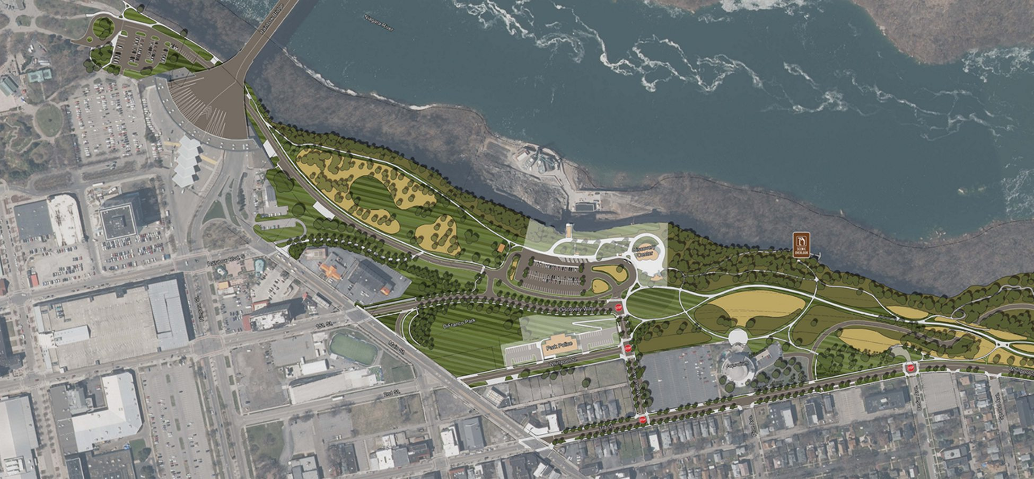
Overview
Last Vestige of Expressway – Redesign for Trolley & Security Access
Gorge Discovery Center
New Driveway
for Pumping Station Access
Discovery Way
Main St.
DiFranco
Park
Walnut St
Aquarium
Cedar
Spruce
Third St.
Pine
Notes:
With that let’s get started.

Slide 9
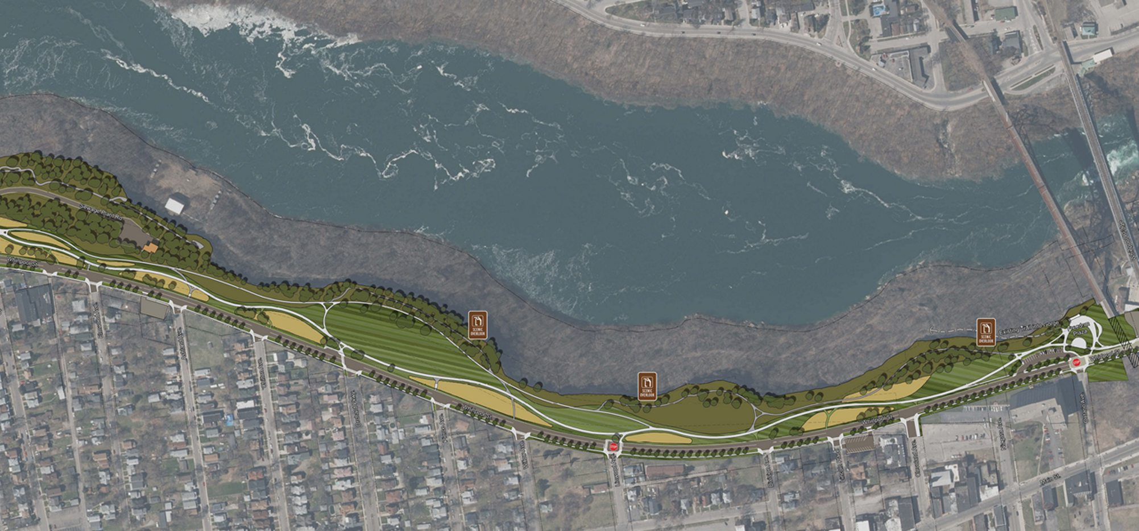
Overview
Great
Lawn
Freedom Plaza
Spruce Alley
Elmwood
Ashland
Chilton
Orchard
Ontario
Pierce
Cleveland
Niagara
Willow
Linwood
Division
Lincoln
Notes:
With that let’s get started.

Slide 10
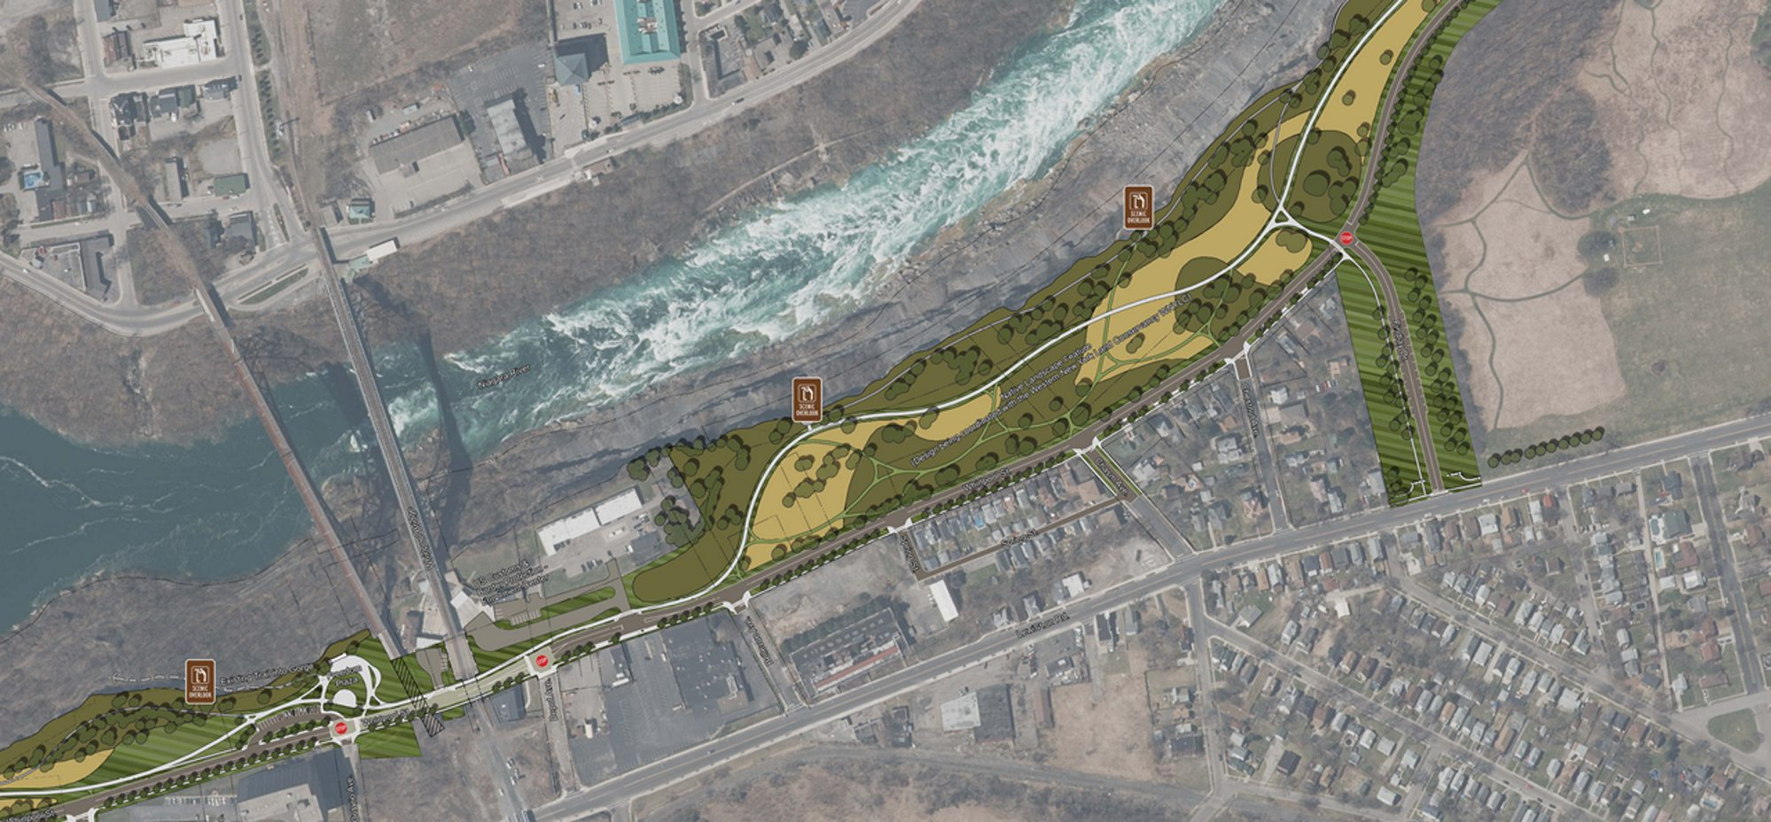
Overview
WNY Land Conservancy
“Feature Landscape”
Findlay Dr
“PedestrianZone”
Chestnut
Chasm
Freedom Plaza
Spring
Bellevue
Train Station/ UGRR Ctr
Depot
Notes:
With that let’s get started.

Slide 11
Public Comments Received
How will you Control Speeds?
Are Left-Hand Turn Lanes Needed?
Accommodating current/future transit
Reduce Parking Lots on Gorge Rim/Use Street Parking
Trails Too Wide/Too Much Pavement
Will each Cross-Street Connect to the Trail System?
Preserving/Enhancing the Natural Setting along the Gorge rim
Need for Tree Surveys, use of native species
How would we “Improve” Overlook Locations?
Notes:
This is the agenda for tonight’s hearing. After this introduction I will go over the purpose of the hearing and some Project background – including what we’ve been working on since our last public meeting in September 2015.
We’ll then go over the Project alternatives that led us to what we refer to as the “Build Alternative” or the Project components that are the subject of this environmental review, and the we will walk you through these features – as part of that Tom Donohue will present a future traffic simulation of the Project.
We will then provide a summary of the anticipated social, economic, and environmental effects of the Project that is documented in detail in the DR/EA.
As is required under the NYS Eminent Domain Procedural Law, Anthony Dispenza will then provide an overview of DOT procedures to secure any temporary or permanent right-of-way that is necessary for the Project – although no major residential or commercial takings or displacements are anticipated.
Finally, we’ve go over where we are in the Project Schedule and then open the floor for your comments.

Slide 12
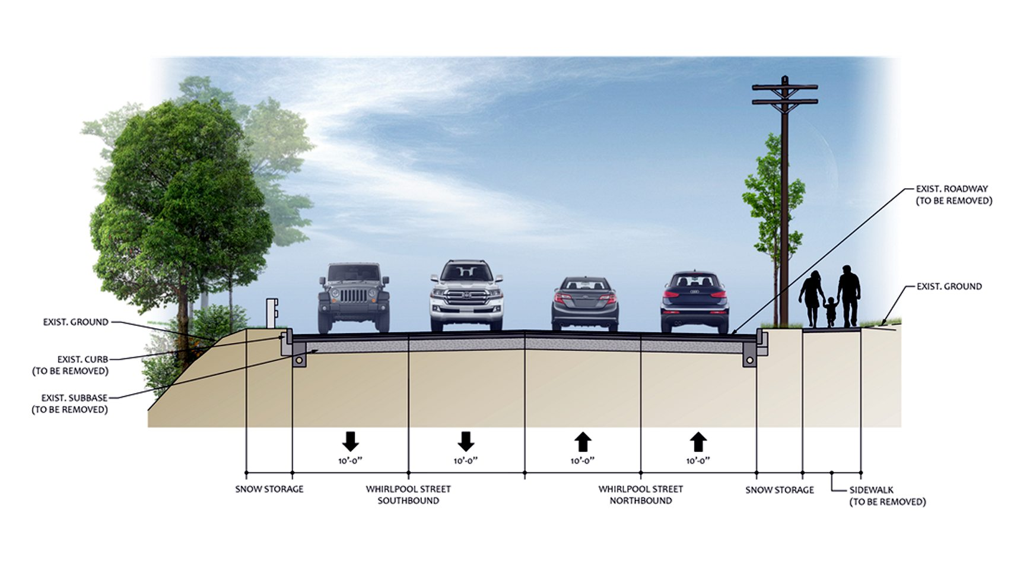
Traffic Calming – Road Sections
Not a lot of traffic,
thus a lot of SPEED
Existing 4-Lane, 40-foot ± Whirlpool Street
Notes:
This is the agenda for tonight’s hearing. After this introduction I will go over the purpose of the hearing and some Project background – including what we’ve been working on since our last public meeting in September 2015.
We’ll then go over the Project alternatives that led us to what we refer to as the “Build Alternative” or the Project components that are the subject of this environmental review, and the we will walk you through these features – as part of that Tom Donohue will present a future traffic simulation of the Project.
We will then provide a summary of the anticipated social, economic, and environmental effects of the Project that is documented in detail in the DR/EA.
As is required under the NYS Eminent Domain Procedural Law, Anthony Dispenza will then provide an overview of DOT procedures to secure any temporary or permanent right-of-way that is necessary for the Project – although no major residential or commercial takings or displacements are anticipated.
Finally, we’ve go over where we are in the Project Schedule and then open the floor for your comments.

Slide 13
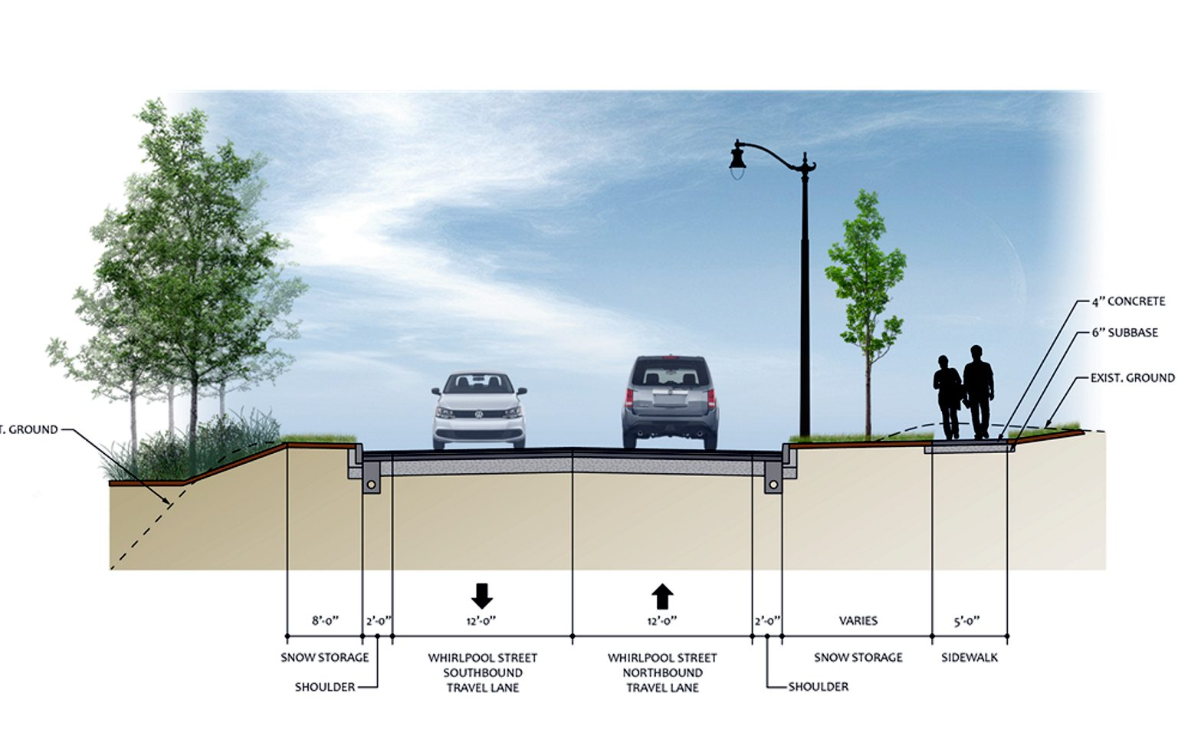
Traffic Calming – Road Sections
Two, 12-foot lanes with 2-foot offsets – Calm traffic while still accommodating bus movements
Proposed 2-Lane, 28-foot Whirlpool Street, without On-Street Parking
Notes:
This is the agenda for tonight’s hearing. After this introduction I will go over the purpose of the hearing and some Project background – including what we’ve been working on since our last public meeting in September 2015.
We’ll then go over the Project alternatives that led us to what we refer to as the “Build Alternative” or the Project components that are the subject of this environmental review, and the we will walk you through these features – as part of that Tom Donohue will present a future traffic simulation of the Project.
We will then provide a summary of the anticipated social, economic, and environmental effects of the Project that is documented in detail in the DR/EA.
As is required under the NYS Eminent Domain Procedural Law, Anthony Dispenza will then provide an overview of DOT procedures to secure any temporary or permanent right-of-way that is necessary for the Project – although no major residential or commercial takings or displacements are anticipated.
Finally, we’ve go over where we are in the Project Schedule and then open the floor for your comments.

Slide 14
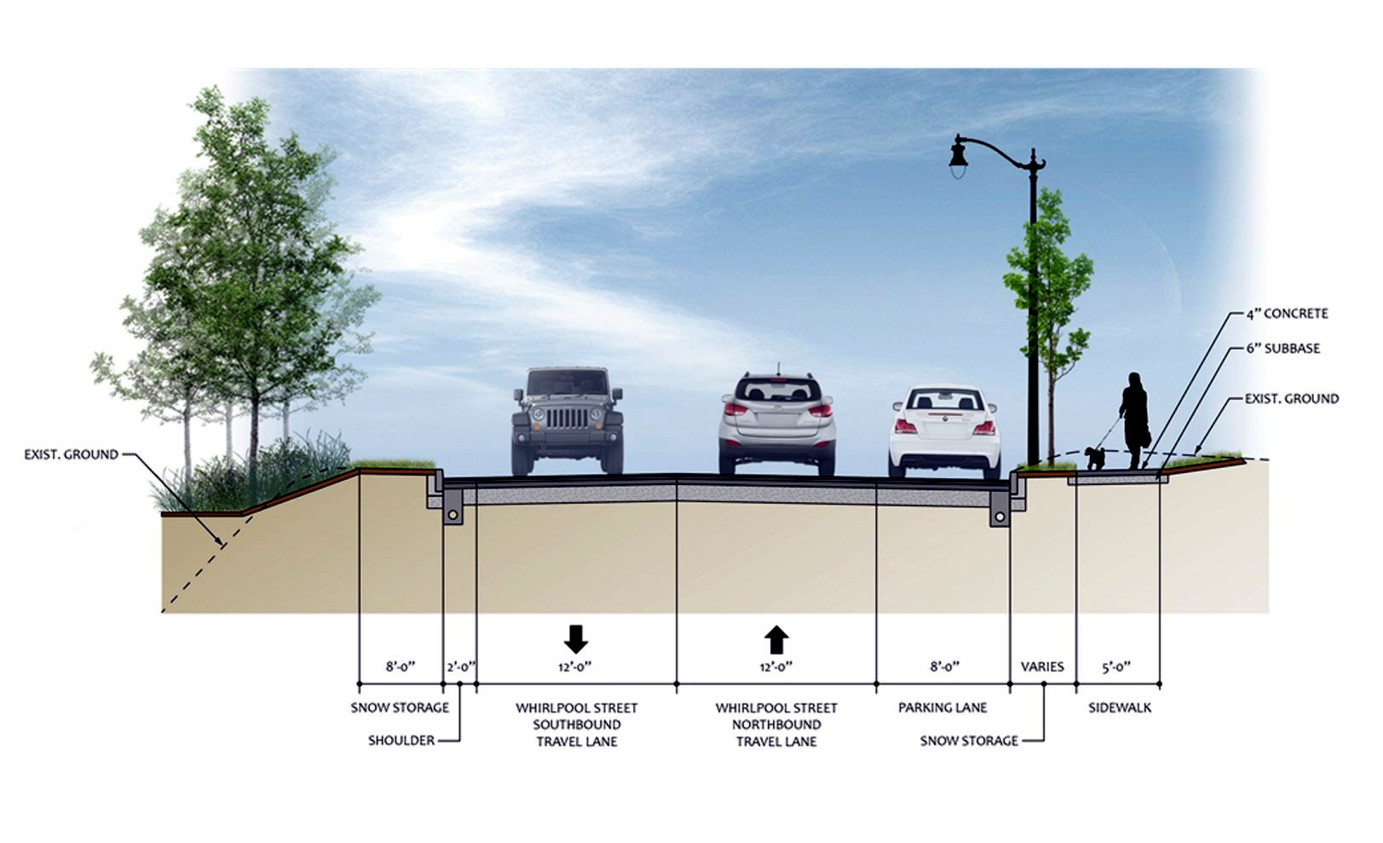
Traffic Calming – Road Sections
Parking only on “City” (east)
side of street
Proposed 2-Lane, 34-foot Whirlpool Street, with On-Street Parking
Notes:
This is the agenda for tonight’s hearing. After this introduction I will go over the purpose of the hearing and some Project background – including what we’ve been working on since our last public meeting in September 2015.
We’ll then go over the Project alternatives that led us to what we refer to as the “Build Alternative” or the Project components that are the subject of this environmental review, and the we will walk you through these features – as part of that Tom Donohue will present a future traffic simulation of the Project.
We will then provide a summary of the anticipated social, economic, and environmental effects of the Project that is documented in detail in the DR/EA.
As is required under the NYS Eminent Domain Procedural Law, Anthony Dispenza will then provide an overview of DOT procedures to secure any temporary or permanent right-of-way that is necessary for the Project – although no major residential or commercial takings or displacements are anticipated.
Finally, we’ve go over where we are in the Project Schedule and then open the floor for your comments.

Slide 15
Traffic Calming & Left Turns: All-Way Stops
Gorge Discovery Center
Lower Niagara River
Whirlpool Br
Former RR Br
Aquarium
Third St.
Whirlpool St.
Main St
Findlay Dr
Gateway Walnut St
Public Pkg Cedar St
Great Lawn/ Orch Pkwy
Public Pkg
Linwood Ave
Ontario St
Depot St
Special Ped Area Train Station & UGRR Ctr
Notes:
With that let’s get started.

Slide 16
Parking
Eliminated Gorge Rim lot and created On-Street Parking
Near Great Lawn
Redesigned Parking
Near “Freedom Plaza”
Gorge Discovery Center
Lower Niagara River
Whirlpool Br
Residential
Main St.
Aquarium
Residential
On-Street Parking
On Findlay Drive
Improving CNF Lot on Whirlpool
Eliminated former Parkway “rest stop” parking area (Great Lawn)
Redesigned parking lot under overpass (“Freedom Plaza”)
Introduced “street parking” near Great Lawn and on Findlay Drive
Maintained street parking near residential frontages.
Improving small City parking lot on Whirlpool St
Notes:
This is the agenda for tonight’s hearing. After this introduction I will go over the purpose of the hearing and some Project background – including what we’ve been working on since our last public meeting in September 2015.
We’ll then go over the Project alternatives that led us to what we refer to as the “Build Alternative” or the Project components that are the subject of this environmental review, and the we will walk you through these features – as part of that Tom Donohue will present a future traffic simulation of the Project.
We will then provide a summary of the anticipated social, economic, and environmental effects of the Project that is documented in detail in the DR/EA.
As is required under the NYS Eminent Domain Procedural Law, Anthony Dispenza will then provide an overview of DOT procedures to secure any temporary or permanent right-of-way that is necessary for the Project – although no major residential or commercial takings or displacements are anticipated.
Finally, we’ve go over where we are in the Project Schedule and then open the floor for your comments.

Slide 17
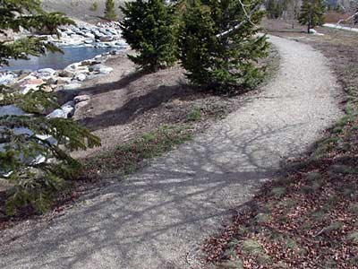
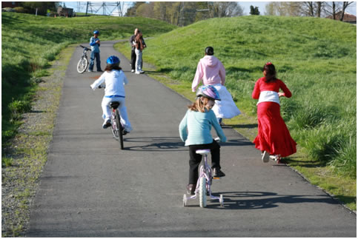
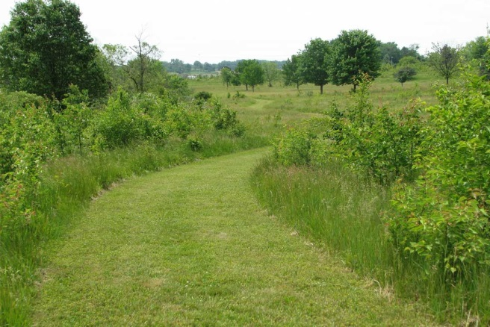
Trail System
Reduced width of main trail from 13 feet to 10 feet (like Riverway Project)
Introducing other trail/walk types – connect to every street
Stone Dust Trail
Paved Trail
Grass Trail
Notes:
This is the agenda for tonight’s hearing. After this introduction I will go over the purpose of the hearing and some Project background – including what we’ve been working on since our last public meeting in September 2015.
We’ll then go over the Project alternatives that led us to what we refer to as the “Build Alternative” or the Project components that are the subject of this environmental review, and the we will walk you through these features – as part of that Tom Donohue will present a future traffic simulation of the Project.
We will then provide a summary of the anticipated social, economic, and environmental effects of the Project that is documented in detail in the DR/EA.
As is required under the NYS Eminent Domain Procedural Law, Anthony Dispenza will then provide an overview of DOT procedures to secure any temporary or permanent right-of-way that is necessary for the Project – although no major residential or commercial takings or displacements are anticipated.
Finally, we’ve go over where we are in the Project Schedule and then open the floor for your comments.

Slide 18
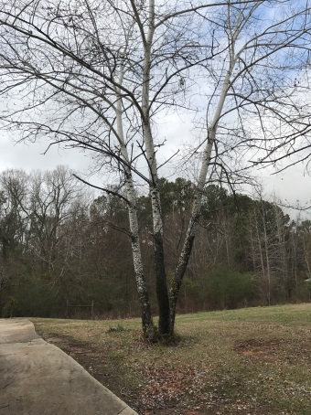
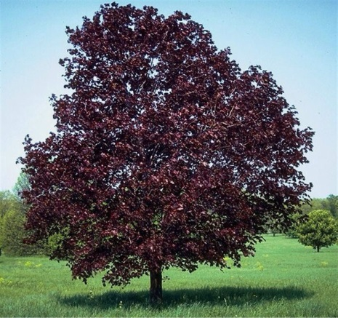
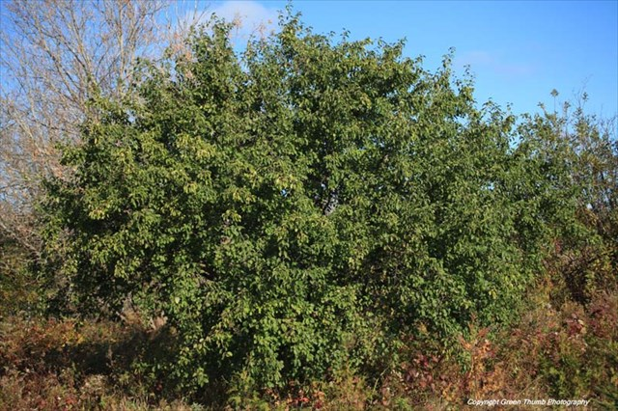
The Natural Setting: Invasive Species Control
Detail tree survey conducted of all trees 6” dbh
Tree clearings – invasive species and other low value trees along Whirlpool/Parkway divide
Other tree & scrub/shrub removals
Coordination with WNY Land Conservancy
“Green Wall”
To be largely cleared except for key specimen
White Poplar
Common Buckthorn
Norway Maple
Notes:
This is the agenda for tonight’s hearing. After this introduction I will go over the purpose of the hearing and some Project background – including what we’ve been working on since our last public meeting in September 2015.
We’ll then go over the Project alternatives that led us to what we refer to as the “Build Alternative” or the Project components that are the subject of this environmental review, and the we will walk you through these features – as part of that Tom Donohue will present a future traffic simulation of the Project.
We will then provide a summary of the anticipated social, economic, and environmental effects of the Project that is documented in detail in the DR/EA.
As is required under the NYS Eminent Domain Procedural Law, Anthony Dispenza will then provide an overview of DOT procedures to secure any temporary or permanent right-of-way that is necessary for the Project – although no major residential or commercial takings or displacements are anticipated.
Finally, we’ve go over where we are in the Project Schedule and then open the floor for your comments.

Slide 19
The Natural Setting: Overlook Locations
No changes to well-established overlooks
At new/underdeveloped locations – using a very light hand in improvements
Notes:
This is the agenda for tonight’s hearing. After this introduction I will go over the purpose of the hearing and some Project background – including what we’ve been working on since our last public meeting in September 2015.
We’ll then go over the Project alternatives that led us to what we refer to as the “Build Alternative” or the Project components that are the subject of this environmental review, and the we will walk you through these features – as part of that Tom Donohue will present a future traffic simulation of the Project.
We will then provide a summary of the anticipated social, economic, and environmental effects of the Project that is documented in detail in the DR/EA.
As is required under the NYS Eminent Domain Procedural Law, Anthony Dispenza will then provide an overview of DOT procedures to secure any temporary or permanent right-of-way that is necessary for the Project – although no major residential or commercial takings or displacements are anticipated.
Finally, we’ve go over where we are in the Project Schedule and then open the floor for your comments.

Slide 20
Other Items We Working On
Notes:
This is the agenda for tonight’s hearing. After this introduction I will go over the purpose of the hearing and some Project background – including what we’ve been working on since our last public meeting in September 2015.
We’ll then go over the Project alternatives that led us to what we refer to as the “Build Alternative” or the Project components that are the subject of this environmental review, and the we will walk you through these features – as part of that Tom Donohue will present a future traffic simulation of the Project.
We will then provide a summary of the anticipated social, economic, and environmental effects of the Project that is documented in detail in the DR/EA.
As is required under the NYS Eminent Domain Procedural Law, Anthony Dispenza will then provide an overview of DOT procedures to secure any temporary or permanent right-of-way that is necessary for the Project – although no major residential or commercial takings or displacements are anticipated.
Finally, we’ve go over where we are in the Project Schedule and then open the floor for your comments.

Slide 21
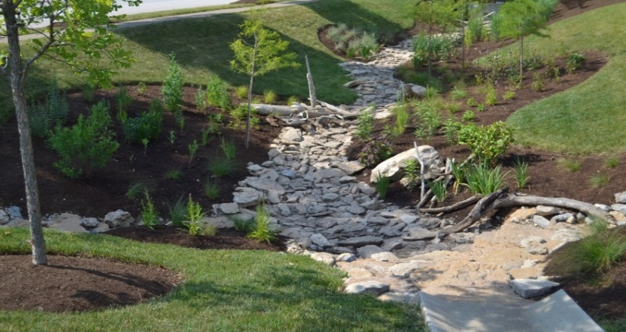
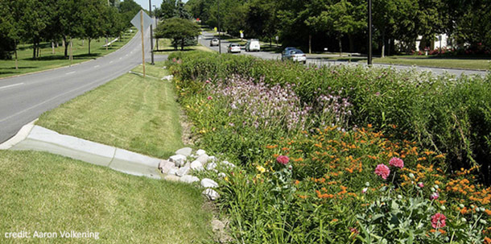
“Green” Infrastructure/Drainage
Significant reduction in storm runoff to Niagara River from Parkway removal.
Also working to remove as much Whirlpool Street storm runoff as feasible from entering City’s combined sewer system.
Typical techniques: bio-swales & raingarden as part of the drainage/landscape design
Typical bio-swale in a landscape design
Typical Raingarden
Notes:
This is the agenda for tonight’s hearing. After this introduction I will go over the purpose of the hearing and some Project background – including what we’ve been working on since our last public meeting in September 2015.
We’ll then go over the Project alternatives that led us to what we refer to as the “Build Alternative” or the Project components that are the subject of this environmental review, and the we will walk you through these features – as part of that Tom Donohue will present a future traffic simulation of the Project.
We will then provide a summary of the anticipated social, economic, and environmental effects of the Project that is documented in detail in the DR/EA.
As is required under the NYS Eminent Domain Procedural Law, Anthony Dispenza will then provide an overview of DOT procedures to secure any temporary or permanent right-of-way that is necessary for the Project – although no major residential or commercial takings or displacements are anticipated.
Finally, we’ve go over where we are in the Project Schedule and then open the floor for your comments.

Slide 22
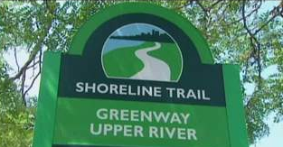
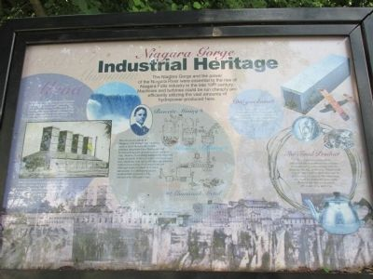
Trail Blazers & Historic Markers
Coordinating with National Heritage Area, UGGR Interpretative Center, and other local input
Coordinating with standard designs for Shoreline Trail and other State Parks’ standards
Shoreline Trail Signs
Historic/Interpretative Markers
Notes:
This is the agenda for tonight’s hearing. After this introduction I will go over the purpose of the hearing and some Project background – including what we’ve been working on since our last public meeting in September 2015.
We’ll then go over the Project alternatives that led us to what we refer to as the “Build Alternative” or the Project components that are the subject of this environmental review, and the we will walk you through these features – as part of that Tom Donohue will present a future traffic simulation of the Project.
We will then provide a summary of the anticipated social, economic, and environmental effects of the Project that is documented in detail in the DR/EA.
As is required under the NYS Eminent Domain Procedural Law, Anthony Dispenza will then provide an overview of DOT procedures to secure any temporary or permanent right-of-way that is necessary for the Project – although no major residential or commercial takings or displacements are anticipated.
Finally, we’ve go over where we are in the Project Schedule and then open the floor for your comments.

Slide 23
Project Staging
North
Lower Niagara River
Main St.
Parkway
Findlay Dr.
Third St.
Whirlpool St.
Whirlpool Street & Third Street
Utility work – sewer/water
Reconstruction: May involve street closures on portions of Whirlpool/Third
Other Streets/Facilities
Parkway Demolition
Gorge restoration, landscape/trail improvements
Working with City on Website to reporting on progress/upcoming construction
Notes:
With that let’s get started.

Slide 24
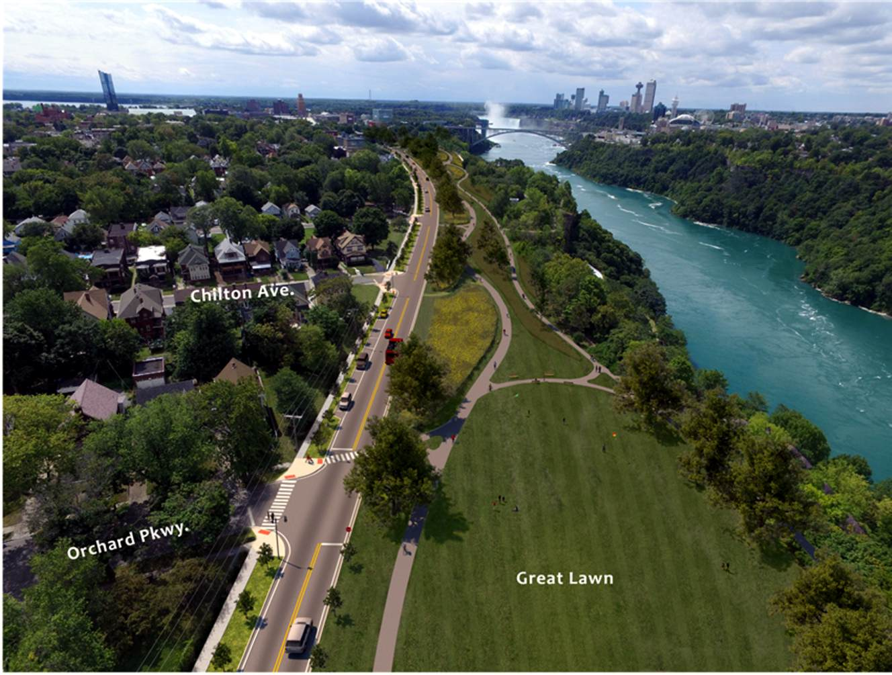
Download Tonight’s Materials
https://parks.ny.gov/inside-our-agency/public-documents.aspx
Scroll down to: “Robert Moses Parkway - North Segment”
Notes:
This is the agenda for tonight’s hearing. After this introduction I will go over the purpose of the hearing and some Project background – including what we’ve been working on since our last public meeting in September 2015.
We’ll then go over the Project alternatives that led us to what we refer to as the “Build Alternative” or the Project components that are the subject of this environmental review, and the we will walk you through these features – as part of that Tom Donohue will present a future traffic simulation of the Project.
We will then provide a summary of the anticipated social, economic, and environmental effects of the Project that is documented in detail in the DR/EA.
As is required under the NYS Eminent Domain Procedural Law, Anthony Dispenza will then provide an overview of DOT procedures to secure any temporary or permanent right-of-way that is necessary for the Project – although no major residential or commercial takings or displacements are anticipated.
Finally, we’ve go over where we are in the Project Schedule and then open the floor for your comments.

Slide 25
Thank You. Adjourn to Grand Foyer for Refreshments and Review of Plans
Notes:
This is the agenda for tonight’s hearing. After this introduction I will go over the purpose of the hearing and some Project background – including what we’ve been working on since our last public meeting in September 2015.
We’ll then go over the Project alternatives that led us to what we refer to as the “Build Alternative” or the Project components that are the subject of this environmental review, and the we will walk you through these features – as part of that Tom Donohue will present a future traffic simulation of the Project.
We will then provide a summary of the anticipated social, economic, and environmental effects of the Project that is documented in detail in the DR/EA.
As is required under the NYS Eminent Domain Procedural Law, Anthony Dispenza will then provide an overview of DOT procedures to secure any temporary or permanent right-of-way that is necessary for the Project – although no major residential or commercial takings or displacements are anticipated.
Finally, we’ve go over where we are in the Project Schedule and then open the floor for your comments.

